Slide 1
TRANSAX: A Blockchain-based Decentralized Forward-Trading Energy Exchange for Transactive Microgrids
Scott Eisele² Aron Laszka¹ Gabor Karsai² Abhishek Dubey² Karla Kvaternik³
¹ University of Houston
² Institute for Software Integrated Systems, Vanderbilt University
³ Siemens CT, Princeton NJ
Notes:
I’m going to share our work Transax.
A blockchain-based
Decentralized Forward-Trading Energy Exchange
for Transactive Microgrids.

Slide 2
Smart and Connected Cyber-physical systems
Residents and their environments are increasingly connected through rapidly-changing intelligent technologies.
Individuals have control over resources that have value to their neighbors.
Our goal is to develop a platform to allow users to exchange these resources in a resilient and trustworthy manner.
We are specially concerned with electrical energy distribution systems.
Notes:
The motivation for this work is the emergence of smart and connected cyber physical systems
As residents are more connected to each other and their environments it opens the potential for exchanging resources they value.
Our goal is to develop a platform that allows such exchanges.
This work is focused on energy distribution.

Slide 3

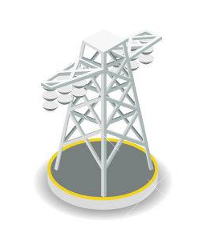
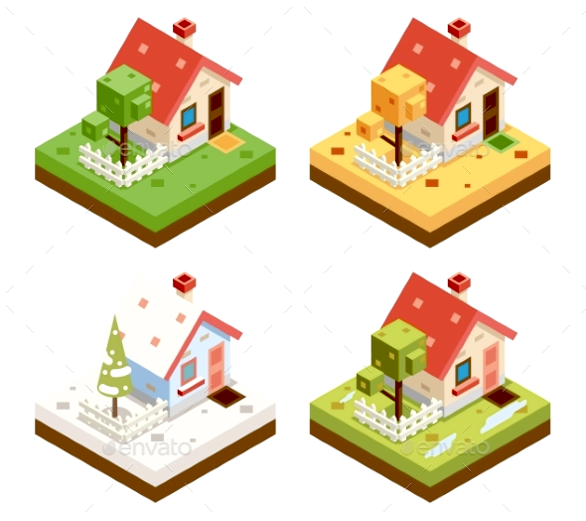
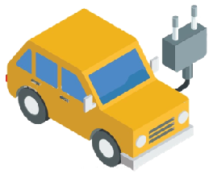


Smart and Connected Energy Distribution Systems
Distribution System Operator
Transactive Energy: The participants can buy and sell energy directly
Notes:
Traditional energy distribution is centralized
But with the addition of distributed energy resources transferring energy back to the main grid became is an option.
This also provides the opportunity for transferring energy directly between agents.

Slide 4
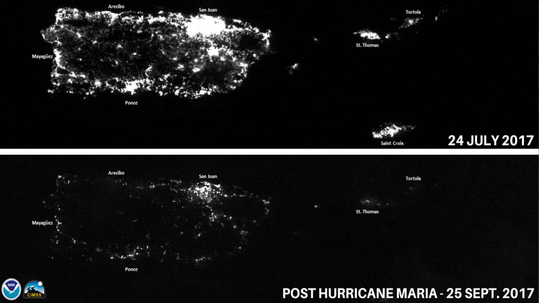
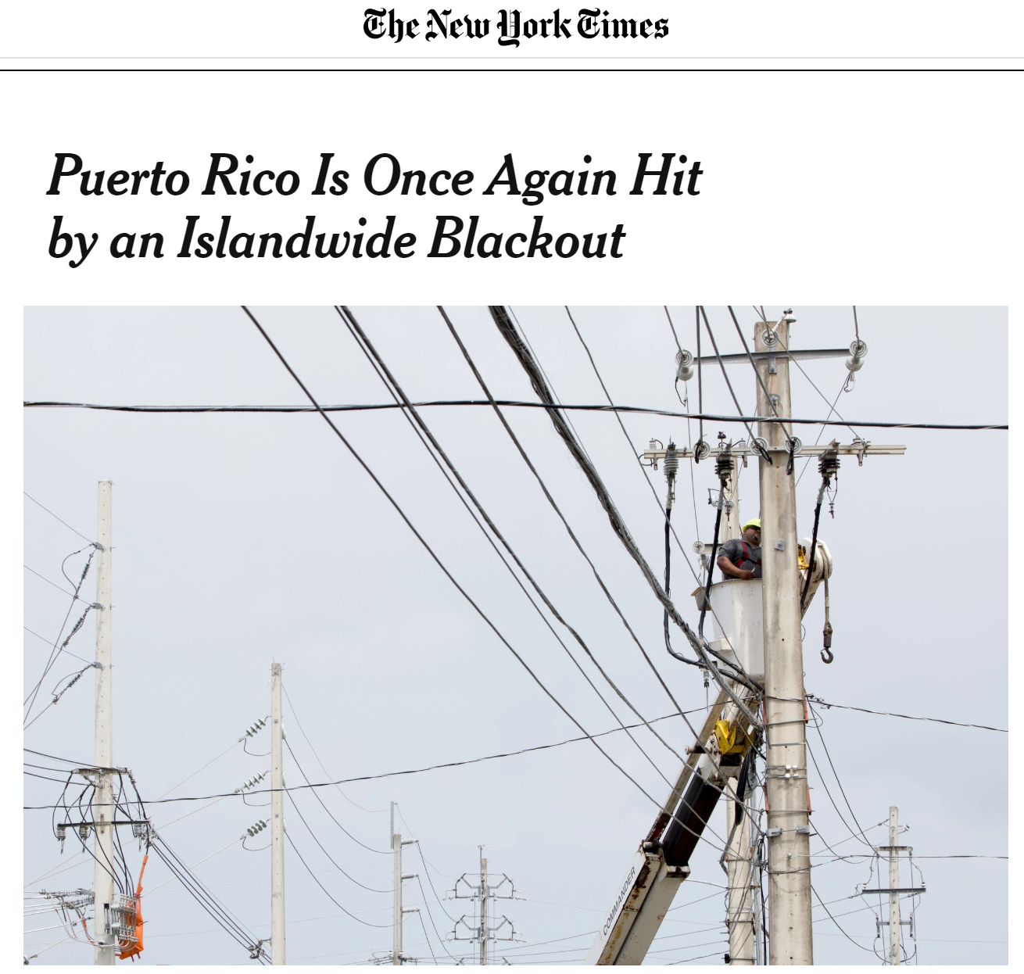
Why is this important
Move from Centralized generation and control to distributed generation and control which enables resilience
Allow consumers to be active participants
Reduce load on current infrastructure
Notes:
Including the customers in the market is important because it enables resilience, if any peers remain connected their microgrid can continue to function. The tradeoffs between resilience and aggregation can be investigated further.
It also reduces the load on the current infrastructure.
Checks wo centralized node
Can handle failures
Doesn’t require dedicated infrastructure. (REALLY HARD TO TARGET)

Slide 5
Concerns
Trust between peers
Stability and Safety of system
Privacy
Resilience to participant failure
Notes:
This approach however is not without challenges.
These include, Trust between peers, despite potentially malicious, or faulty agents
Ensuring that trades that would degrade stability and safety are not permitted.
Maintaining privacy, since private information could be inferred from the trades, such as when a user will be home based on offers
and resilience to agent failure, which can happen fast and destabilize the system if they are not dealt with.

Slide 6
Designing Implementation
Notes:
For our current implementation design, we focus on the following requirements …

Slide 7
Requirements
Decentralized Control and optimization
Requires solution of an allocation problem
Requires real-time information dissemination & time-synchronized task execution
Decentralized Information
Preserve information integrity across all actors in the system
Support for information aggregation & transactions
Requires consensus & distributed ledger
Resilience
Handle component failures gracefully

Slide 8
Resilient Information Architecture Platform for Smart Grid
RIAPS is an open source software platform to run Smart Grid applications.
It provides
Programming model (for distributed real-time software)
Services (for application management, fault tolerance, security, time synchronization, coordination, etc.)
Development toolkit (for building and deploying apps)
https://riaps.isis.vanderbilt.edu/ -- Now a Linux Foundation Project
Notes:
To provide real-time information dissemination, time-synchronized task execution, and component failures we incorporated RIAPS
Which is an open source software platform for smart grid applications and it provides …

Slide 9
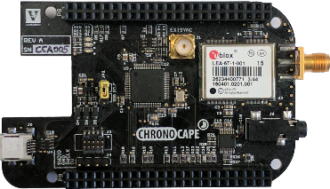
Integration with distributed ledger
Each device running within homes has an interface to store the blockchain data and interact with miners on the network running smart contract code.
Thus, devices can communicate using RIAPS as well as store ledger data using blockchain.
IoT Device running within homes
Notes:
We integrate RIAPS with a distributed ledger to aid in finding a solution of an allocation problem by supporting information aggregation & transactions
Blockchain is also used to enforce safety constraints on offers.

Slide 10

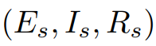
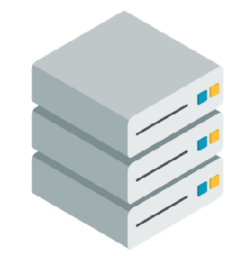
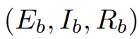
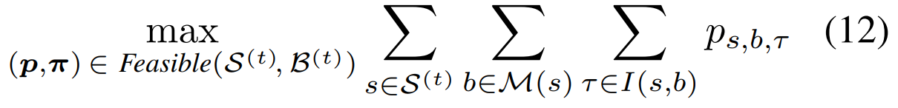
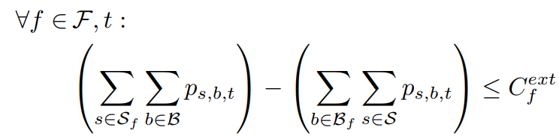
Decentralized Control and Optimization Setup
solvable with an efficient MILP solver (e.g., CPLEX)
does not scale well with smart contracts
prosumer 1
prosumer 2
Objective :
prosumer 3
Feasibility Constraints:
.
.
.
allocation
A
Notes:
Example objective functions
Platform supports more complex formulations.
In this implementation the objective was to maximize the total power traded

Slide 11
Decentralized Information
Decentralized Information is provided by integrating a distributed actor-based real-time middleware called RIAPS with blockchains.
We use block-chains primarily as a distributed ledger and a mechanism to execute computing procedures that can be validated by any node.

Slide 12
Integration with Solvers
The workflow of the system requires each prosumer to submit bids and offers per operation interval.
The solvers compute optimal allocation.
Smart contract verifies solutions.
The prosumer then actuate solution using RIAPS.
Note that RIAPS provide strong time synchronization capabilities
Smart Contracts
Solvers
Notes:
I mentioned that the blockchain aids in finding a solution to the allocation problem, matching consumption offers with production offers but such computation is expensive to carry out on a blockchain, so we introduce off-chain solvers.
(walk through bullets)

Slide 13
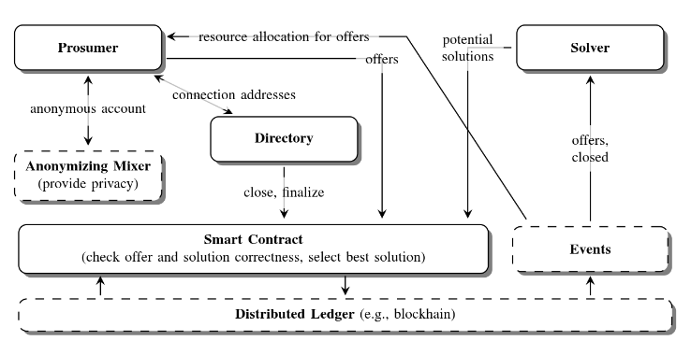
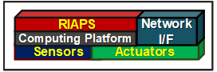
TRANSAX The Full Architecture
Notes:
The full architecture is shown here.

Slide 14
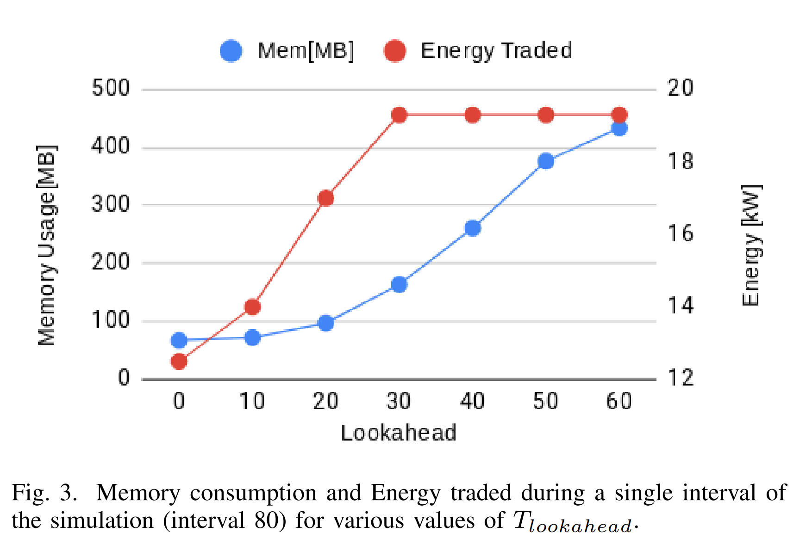
Key Parameters
Prediction window used by prosumers when posting selling and buying offers.
Number of time intervals considered in the future by the solver.
Note that if the solver only considers one step ahead the problem is simpler but the solution might not be optimal.
Length of the time step used for simulating the real interval of length (Applicable during simulation).

Slide 15
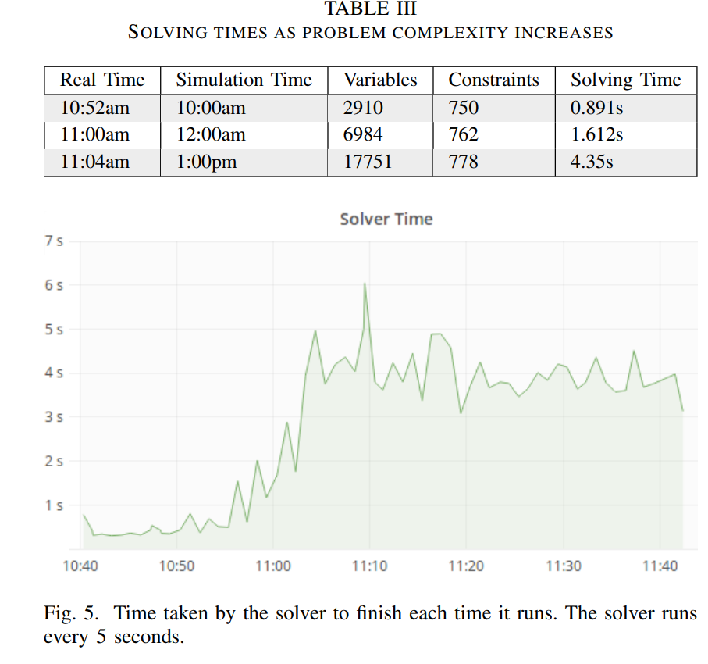
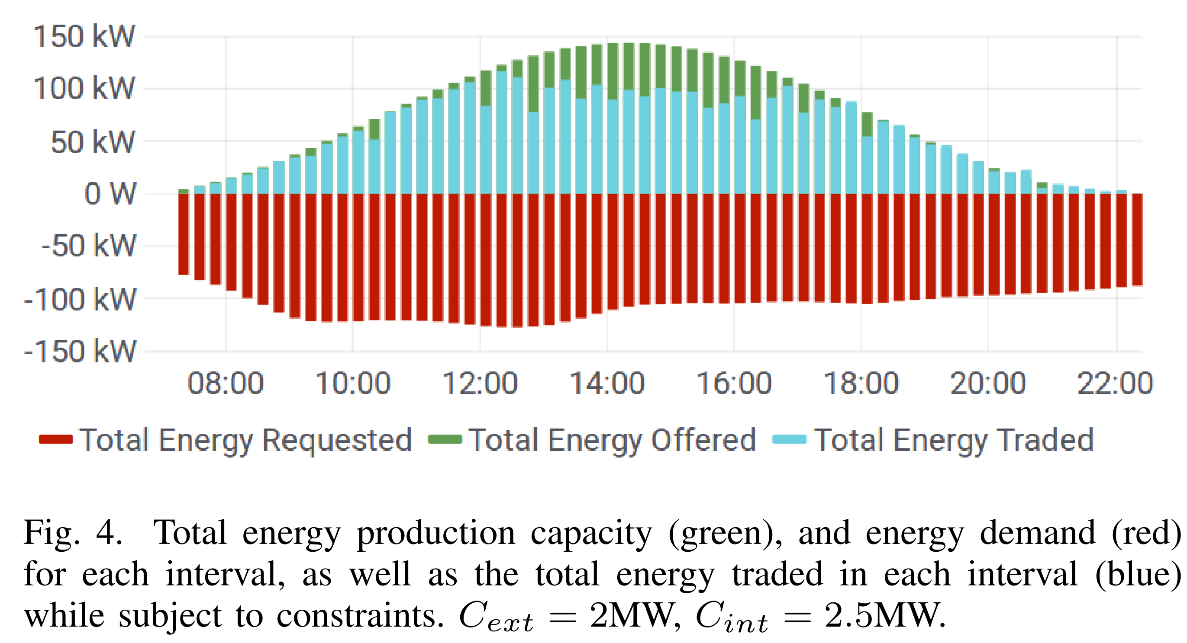
Example Execution
102 homes (5 producers, 97 consumers) across 11 feeders
Notes:
This is an execution run of the platform showing the amount of energy traded(blue) against the amount that was offered(green) and the amount requested (red)
running time of the solver was 23 ms, while the time between the request for finalization and emission of AssignmentFinalized events was 29 s

Slide 16
Handling Faults
Notes:
A little more detail on fault handling

Slide 17
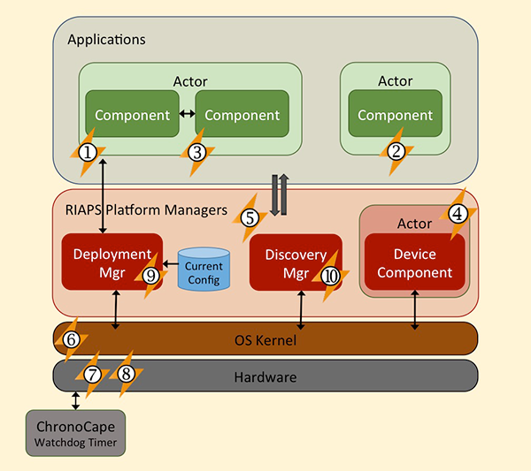
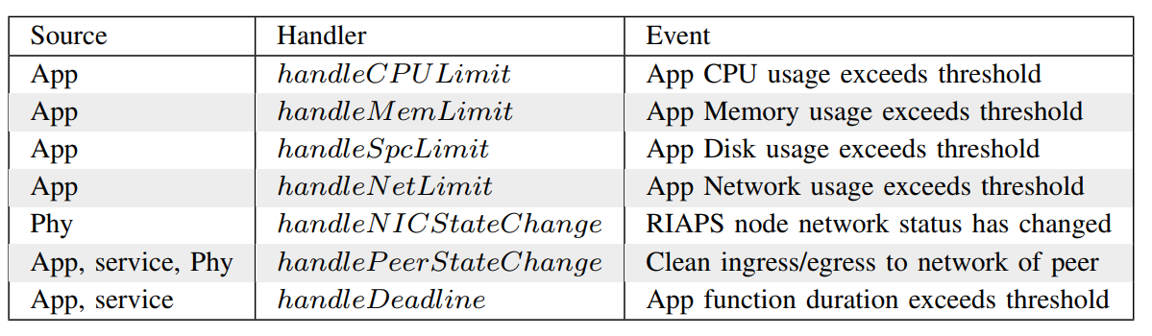
RIAPS : Fault Management
Call back handlers implemented in RIAPS
Notes:
RIAPS provides and allows specification of resource and fault management.
Resource management
Keeps track of resource usage (CPU, memory, files space, I/O)
Manages quotas and access
Signal errors/terminates applications if resource restrictions are violated
Logging
Efficient, low-overhead logging of events in apps and managers
Global management of all logs
Persistence
Efficient, low-overhead database for node-local real-time data
Global management of the database
Fault management
Monitors apps/managers/system for faults
Mitigates fault effects (e.g. automatic restart, checkpoint, etc.)
Security management
Secure information flows among app components
Global management of security keys

Slide 18
Fault Management Example: Handle Prosumer Network Failure
Distributed Ledger
Post Offers
Cancel Trades involving Prosumer for next interval
RIAPS NODE
RIAPS NODE
Actor
Actor
Prosumer
Discovery Manager
Broker Service
DSO
Discovery Manager
Broker Service
DHT
Distributed Coordination Service
Deployment Manager
Application Management and Deployment Service
DHT
Distributed Coordination Service
Deployment Manager
Application Management and Deployment Service
OS Kernel
OS Kernel
PIDs
PIDs
Hardware Platform
Hardware Platform
Device Interfaces
Network Interface(s)
Storage
Device Interfaces
Network Interface(s)
Storage
Notes:
deployment service, resource management, and fault management
Discovery Manager updates DHT. If it stops DHT removes the service after a timeout.

Slide 19
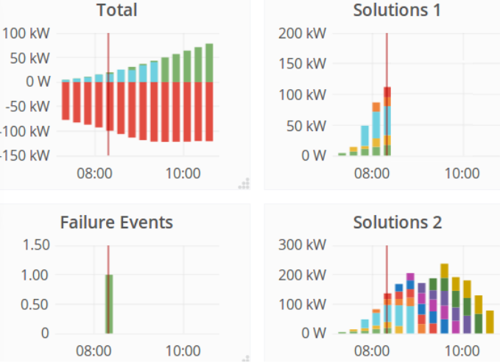
Resilience against Solver failure

Slide 20
Resource Limits Fault Example
Not all faults are node failure faults.
Faults can also be caused due to excessive resource utilization.
This can lead to eventual application failures.

Slide 21
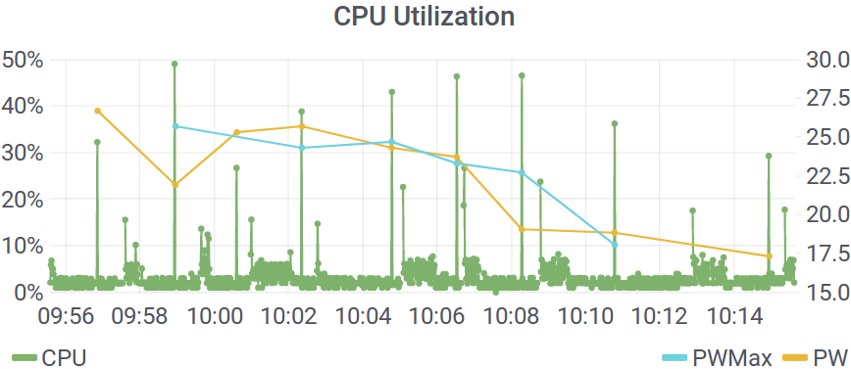
CPU Resource Limit Fault Handling
handleCPULimit reduces the maximum lookahead when the CPU limit is crossed.
Notes:
One case was monitoring the solvers cpu utilization and modulating the number of offers it included while solving to adjust the complexity and reduce cpu utilization.

Slide 22
Summary
we present a decentralized architecture for managing energy transactions and eventually control in microgrids.
the substrate of the architecture is a resilient information architecture middleware called RIAPS. The architecture provides time synchronization capability and discovery services.
The decentralization is enabled by the mix of smart contracts and off-chain solvers. The smart contracts provide a way to implement asynchronous protocol for declaring the intent to trade and finding optimal match and then executing the trade. The ledger provides record of all activities for provenance.
Our past work has shown how we can preserve privacy within the smart contract architecture.

Slide 23
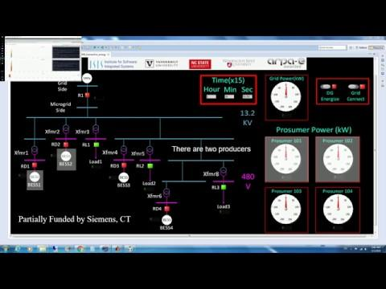
Example

